Slide 1
ULTRASONIC BASED HAND GESTURE CONTROLLED ROBOT

Slide 2
OBJECTIVE
A hand gesture controlled robot is developed using MPU6050, which is a 3-axis Accelerometer and 3-axis Gyroscope sensor and the controller part is Arduino Nano.
Instead of using a remote control with buttons or a joystick, the gestures of the hand are used to control the motion of the robot.
The project is based on wireless communication, where the data from the hand gestures is transmitted to the robot over RF link (RF Transmitter – Receiver pair).

Slide 3
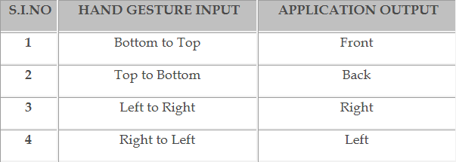
Gesture Controls

Slide 4
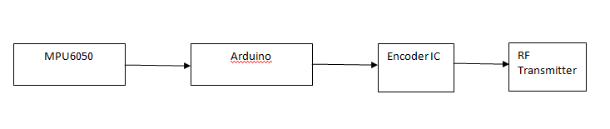
Receiver Block Diagram

Slide 5
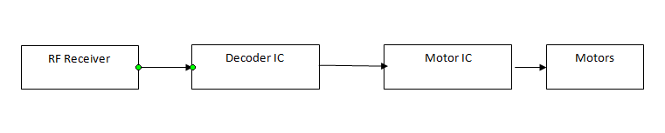
Transmitter Block Diagram

Slide 6
REQUIREMENTS
Software:
Arduino IDE
Hardware:
MPU6050
Arduino
Encoder IC
RF Transmitter
RF Receiver
Decoder IC
Motor IC
Motors
Ultrasonic Sensor

Slide 7
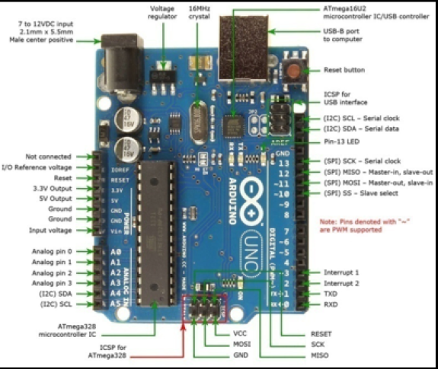
Arduino

Slide 8
Arduino Details
Arduino is an open-source prototyping platform based on ATmega microcontroller and Arduino Uno is one of the most used boards
The Arduino Uno board has 14 digital pins input/output, 6 analog inputs, a 16 MHz clock, a USB connection, a power jack, and a reset button.

Slide 9
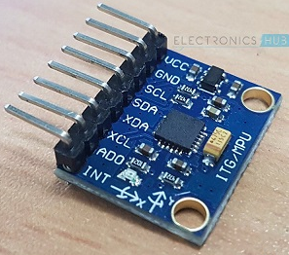
MPU6050
The MPU6050 is one of the most commonly used Sensor Modules by hobbyists and enthusiasts. It consists of Accelerometer and Gyroscope on the same IC and provides 6 Degrees of Freedom (3-axis of Accelerometer and 3-axis of Gyroscope).

Slide 10
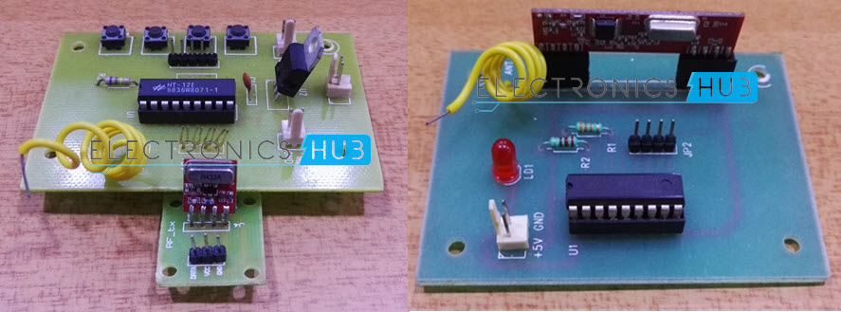
RF Transmitter and Receiver Modules

Slide 11
RF Transmitter and Receiver Modules
The communication between transmitter and receiver is using RF modules. A 434 MHz transmitter and receiver pair are used in this project.
HT-12E:
It is an encoder IC that converts the 4-bit parallel data into serial data in order to transmit over RF link.
HT-12D:
It is a decoder IC that converts the serial data received by the RF Receiver into 4-bit parallel data. This parallel data can be used to drive the motors.

Slide 12
DISADVANTAGE OF EXISTING SYSTEM
Need very high speed image processing
Costly solution
Need high resolution cameras
Highly sensitive to noise in image processing (lens aberrations)

Slide 13
ADVANTAGES OF PROPOSED SYSTEM
Cheaper solution
Easy to develop
Easy to maintain
Easy to replace
Easy to access
Touch less

